Slide 1
Delay of each pipeline stage
1
黃宥翔 chris900623@gmail.com
郭昱 ivan010517@gmail.com

Slide 2
Report Timing
Pipeline Critical Path
單位 : ns
Add
Critical Path
Mul
Critical Path
Add
Mul
Input
Output
TestBench
Hardware
Hardware
TestBench
Pipeline
Pipeline

Slide 3
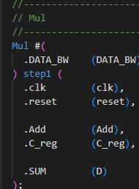
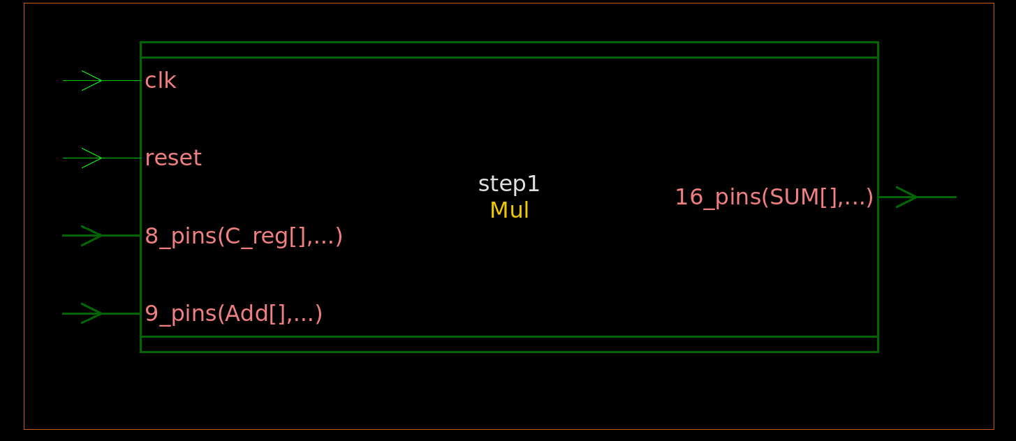
Report Timing
Pipeline Critical Path

Slide 4
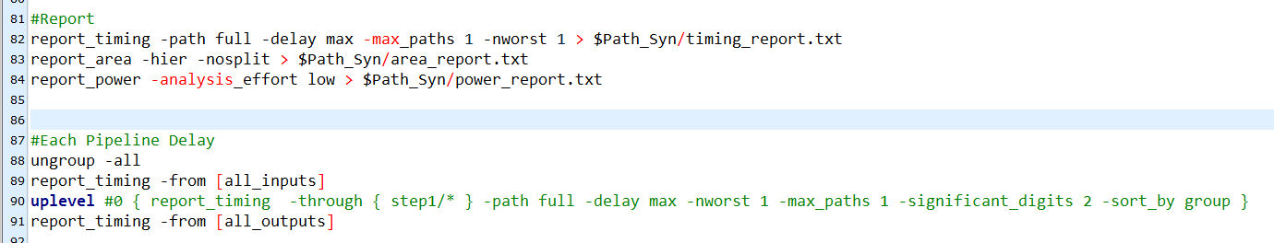
tcl說明
Input Dealy (Add)、Mul Delay (step1)
Output Delay

Slide 5
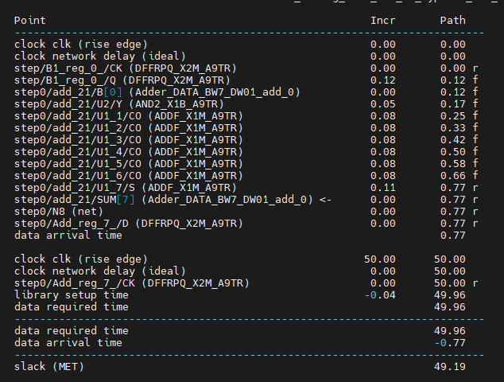
Input Delay(Add)

Slide 6
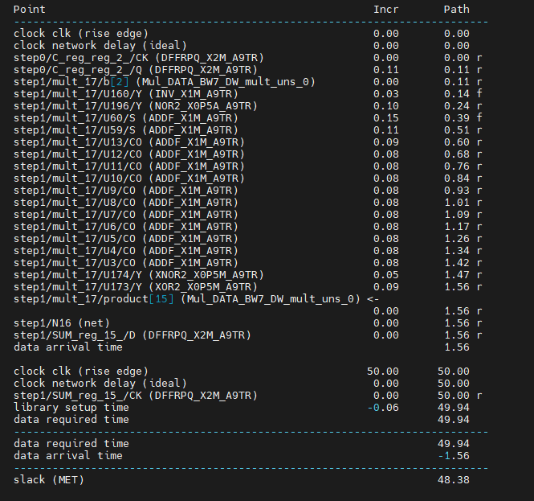
Mul Delay

Slide 7
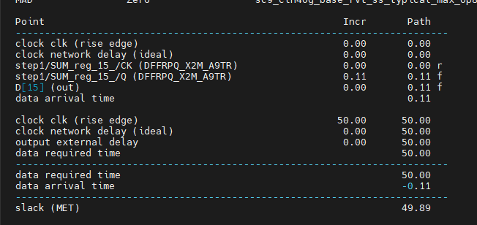
Output Delay

